Slide 1
CMU 10-742 Machine Learning in Healthcare
Lecture 13: Dynamic Treatment Strategies
Notes:
Mini-section of the course on clinical decision support
Last lecture – Prof V on how to help clinicians make decisions at the bedside
This lek covers a proposed system to guide clinicians on treating sepsis
Next – lecture on how to design a CDS system to really help clinicians

Slide 2
Logistics
Assignment 3 Due Today
Final Project Milestone 1 due Thurs Oct 10
Assignment 4 Out Last Thurs (Due Oct 22)

Slide 3
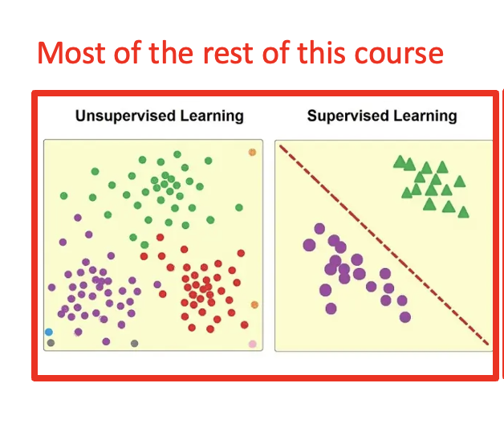
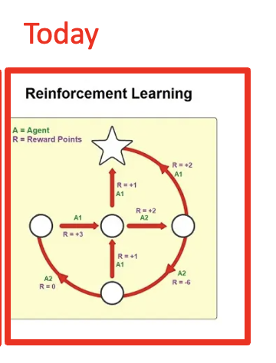
https://www.ejable.com/tech-corner/ai-machine-learning-and-deep-learning/types-of-machine-learning/

Slide 4
Outline
Sepsis
RL Refresher
Experimental Setup
Off-Policy Learning
Results
Concerns

Slide 5
Sepsis
Infection
Bacterial (most common) or viral or fungal infection
Reaction
Body releases chemicals (e.g. cytokines) to fight infection
Septic Shock
Low blood pressure leads to organ damage and death (20% of cases).
Inflammation
The immune system goes into overdrive, causing widespread inflammation and tissue damage
Notes:
“Disregulated immune response to infection”

Slide 6
Two Core Problems
Prediction
Treatment
Notes:
We’ll talk briefly now about prediction, but spend 90% of this lek on treatment

Slide 7
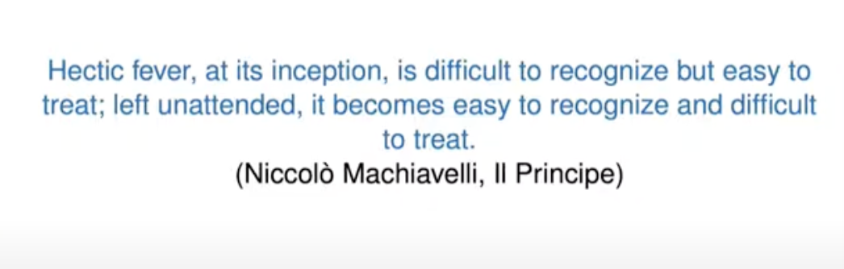
https://www.youtube.com/watch?v=LlmKZgEsGIA
Notes:
True of sepsis as well

Slide 8
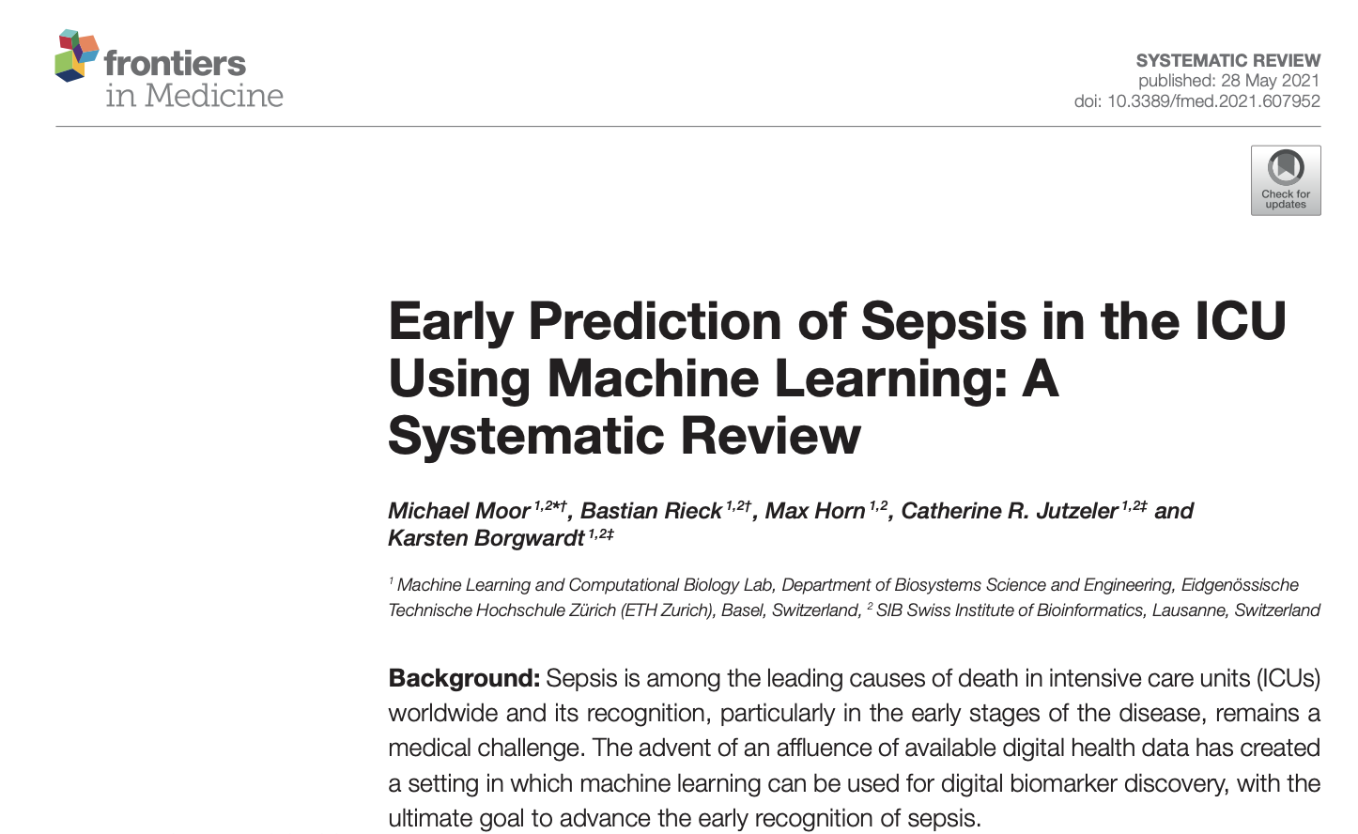
https://www.ncbi.nlm.nih.gov/pmc/articles/PMC8193357/pdf/fmed-08-607952.pdf
Notes:
PREDICTION problem - Good review paper - Karsten Borgwardt and his lab
Literature review & carefully analyzes how well models generalize across diff ICU datasets (e.g. Mimic, Amsterdam)
Pset2 – predict sepsis. How early can u predict it?

Slide 9
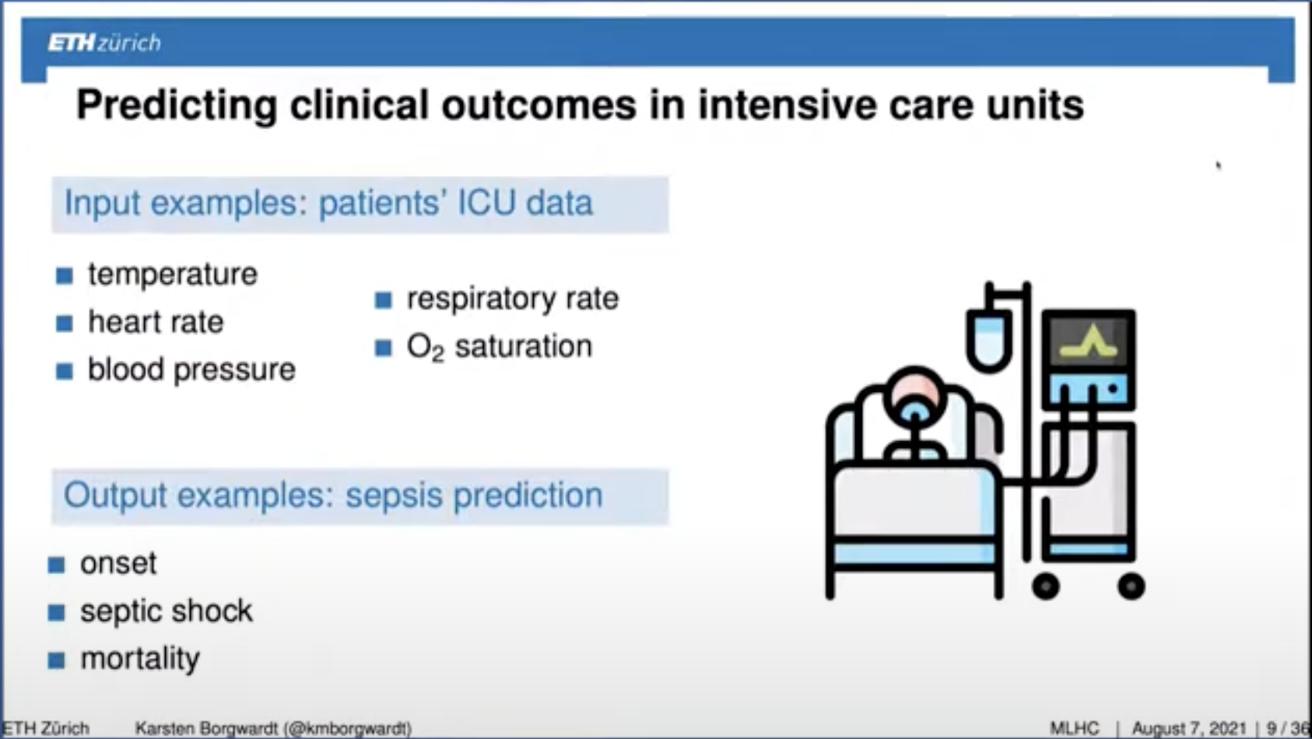
Notes:
From his MLHC’21 talk

Slide 10
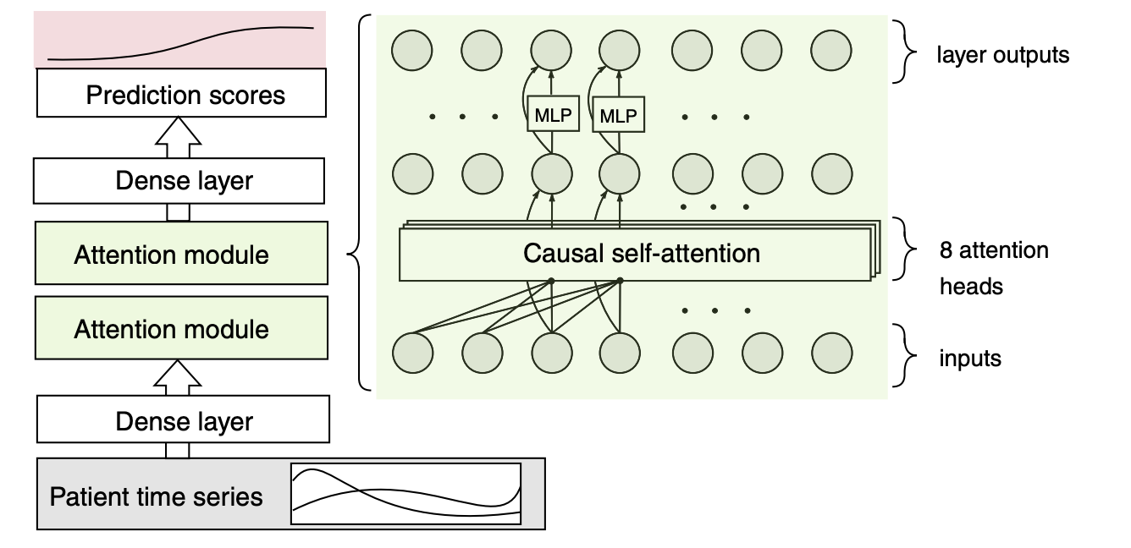
Notes:
This particular approach used transformer-based model

Slide 11
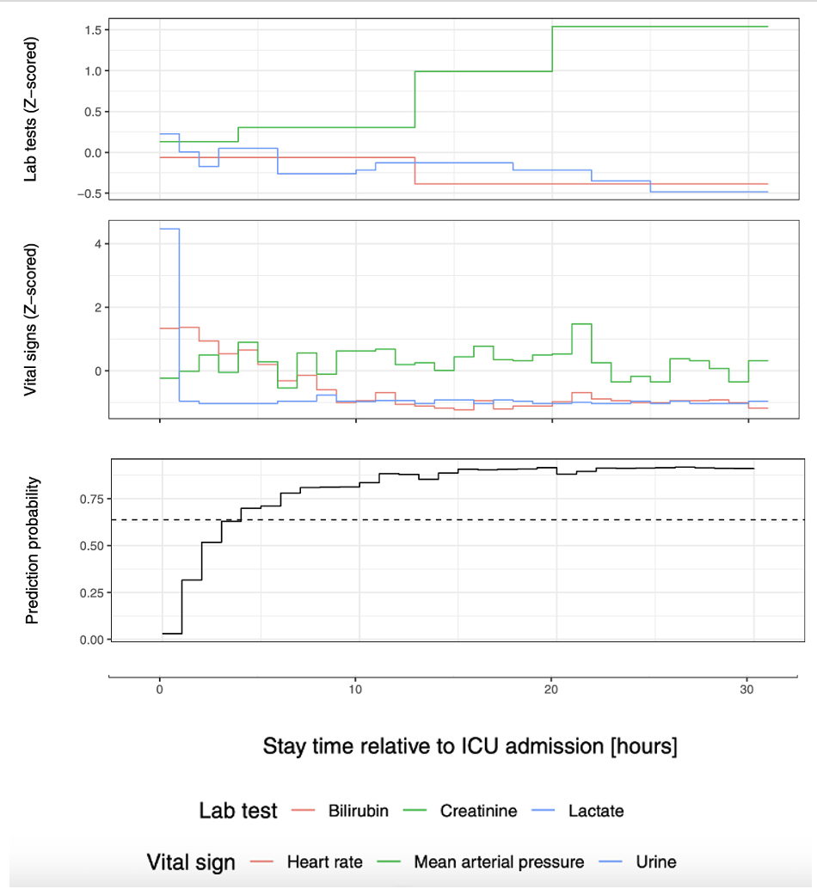
Notes:
Z-score = (z – mean) / std-dev
z-score = 2 means 2 st dev's above the mean

Slide 12
Two Core Problems
Prediction
Treatment
Notes:
Ok that’s all i want to say on prediction, esp since you already had a pset on it.
Now we’re going to focus rest of lecture on treatment

Slide 13
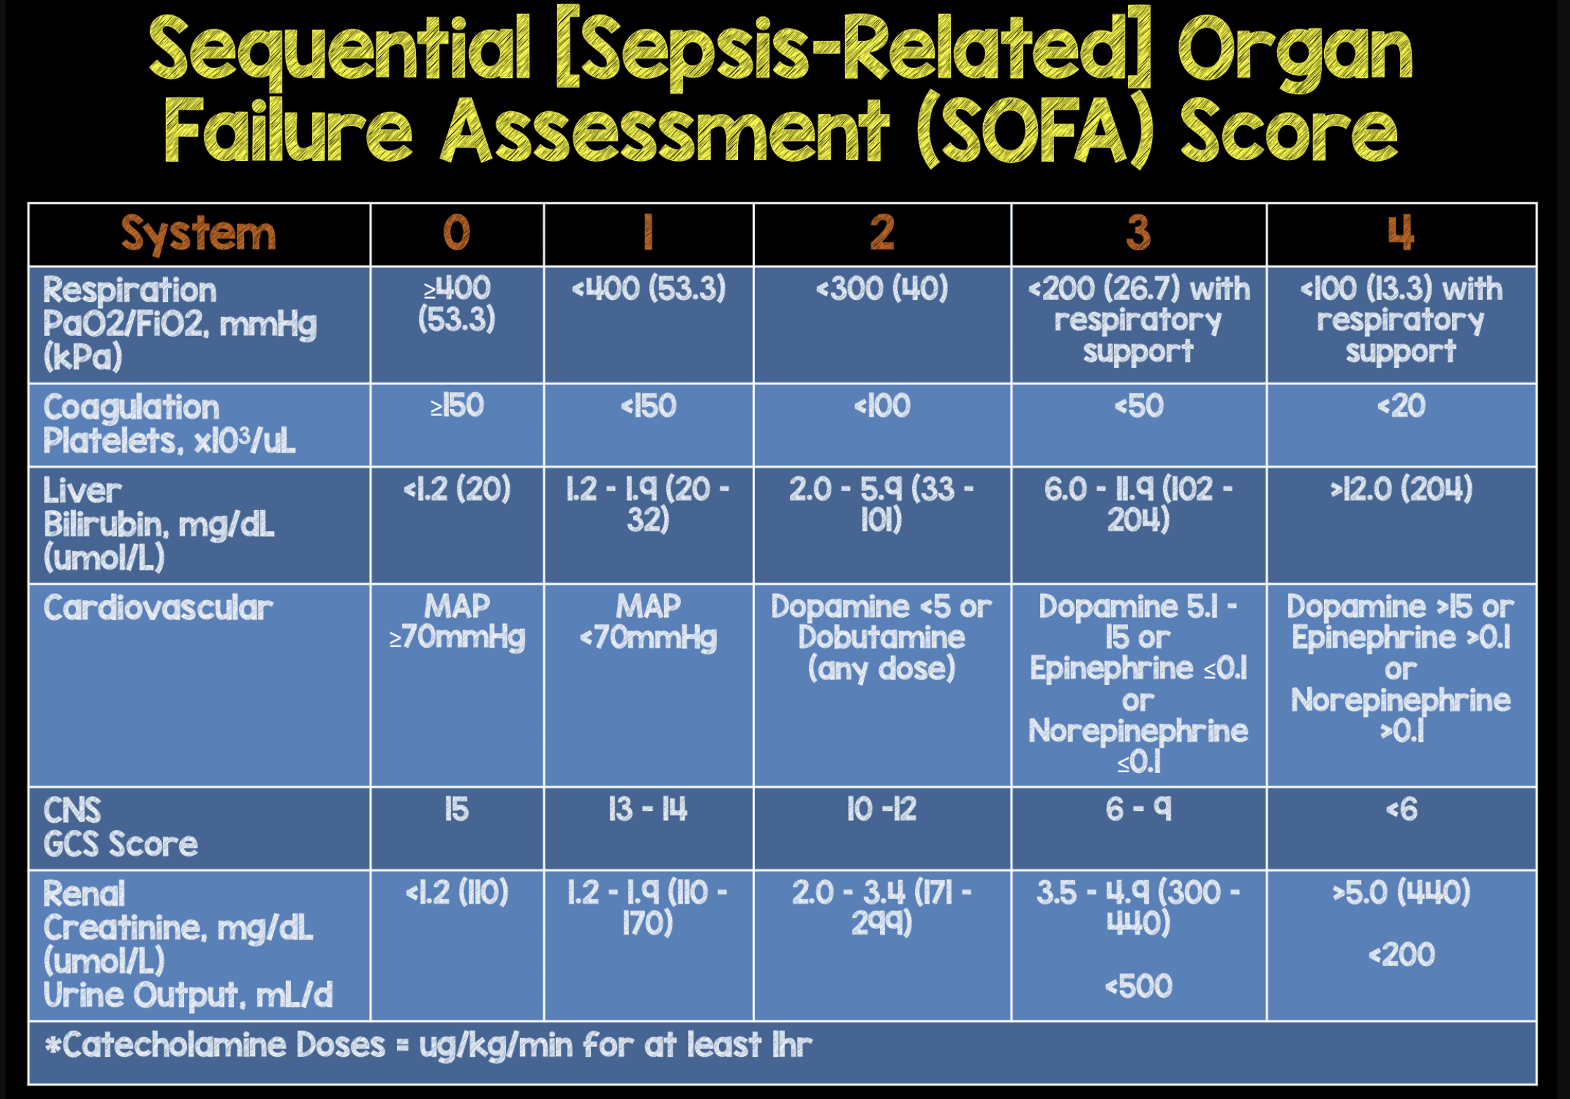
https://rebelem.com/wp-content/uploads/2017/05/SOFA-Score-Sepsis-3.0.png
Notes:
Example of risk stratification method – remember lecture 3?

Slide 14
Common treatment
IV Fluids: address dehydration
Vasopressor: raise blood pressure
Antimicrobials: kill the bad guys
Other “point solutions”: oxygen/mechanical ventilation, dialysis, …
Notes:
Paper focuses on the first two. Not that the others aren’t used, just that the ‘art’ in sepsis treatment is regulating how these are dosed out.
Two levers.
As important as sepsis is, there’s HUGE subjectivity on how best to treat it – more or less IV fluids? More or less vasopressors?
Puzzle - how to turn these levers to maximize chance of survival?

Slide 15
Challenge
Given a dataset of observed sepsis patients, treatments, and outcomes, can we learn an optimal treatment policy?
Notes:
Where might we be able to find such a dataset? (MIMIC!)
Roughly 15K sepsis encounters in MIMIC-IV, depending on your definition

Slide 16
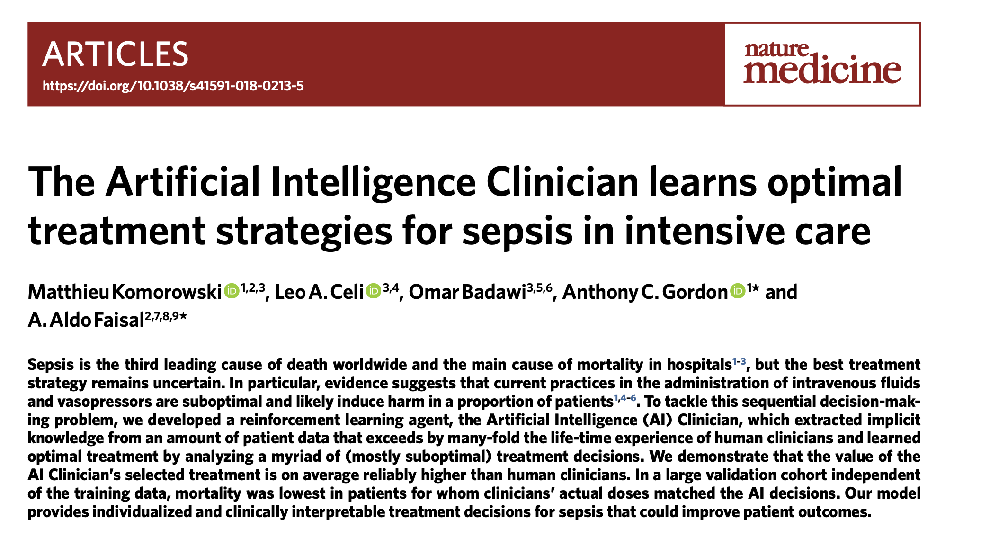
Notes:
Optional reading: followup paper poking holes at it, then a rebuttal from the authors

Slide 17
Outline
Sepsis
RL Refresher
Experimental Setup
Off-Policy Learning
Results
Concerns

Slide 18
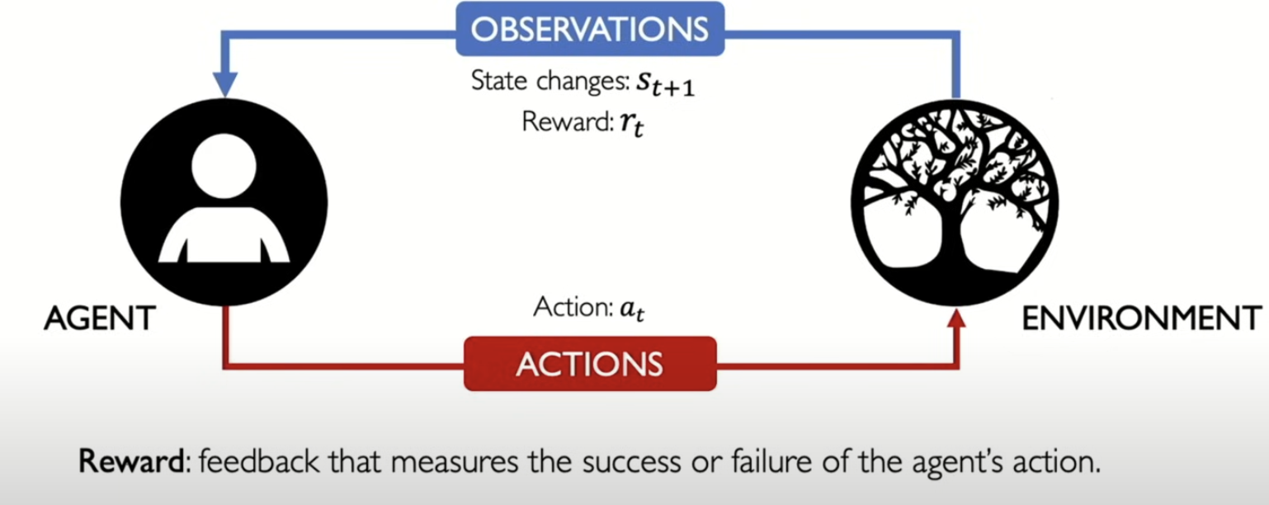
https://www.youtube.com/watch?v=8JVRbHAVCws
Notes:
The next 2 slides are courtesy Alex Amini, who teaches a mini-course at MIT on DL.
((This is NOT Deep RL. Deep RL use DNN to map features to state space. “Regular” RL has smaller state space and simple mapping.))

Slide 19
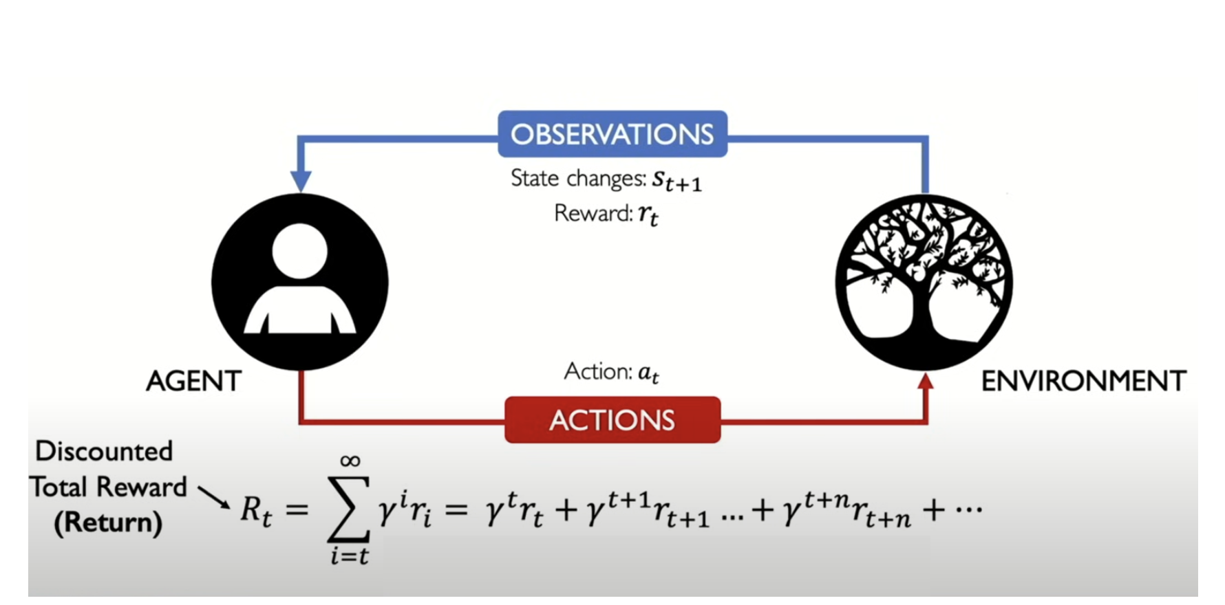
Notes:
Gamma is between 0 and 1
(What does 0 mean? Only care about immediate reward.)
(What does 1 mean? Care equally– no discount)

Slide 20
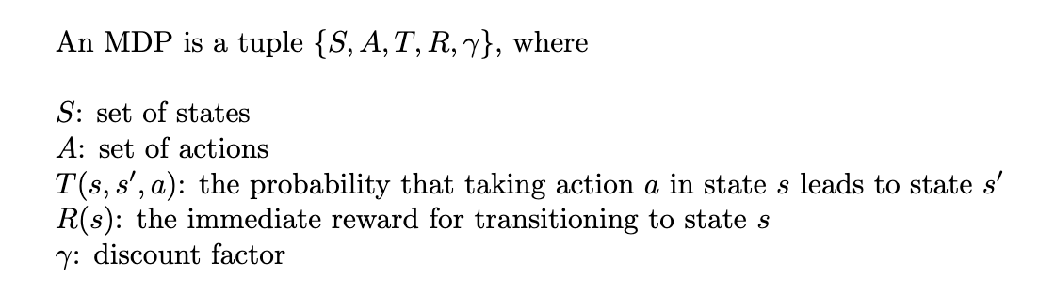
Markov Decision Process (MDP)
Notes:
Let’s formalize all this.
T(s,s’,a) is stochastic, R(s) is deterministic.

Slide 21
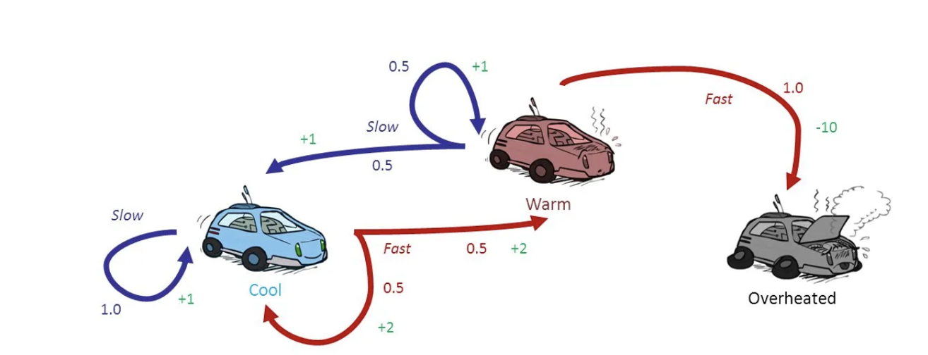
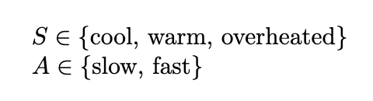
Example
https://sanchittanwar75.medium.com/markov-chains-and-markov-decision-process-e91cda7fa8f2
Notes:
How many states?
How many actions?
If you take action ‘slow’ in state ‘warm’, what happens?
There’s one thing not specified here: what is the agent’s behavior?
A POLICY – tells us what action to take in each state
What does a policy look like ? P(a | s)

Slide 22
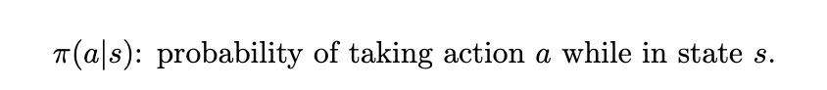
Now Let’s Add a Policy
Notes:
Examples of policies for this car MDP?

Slide 23
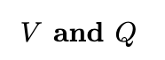
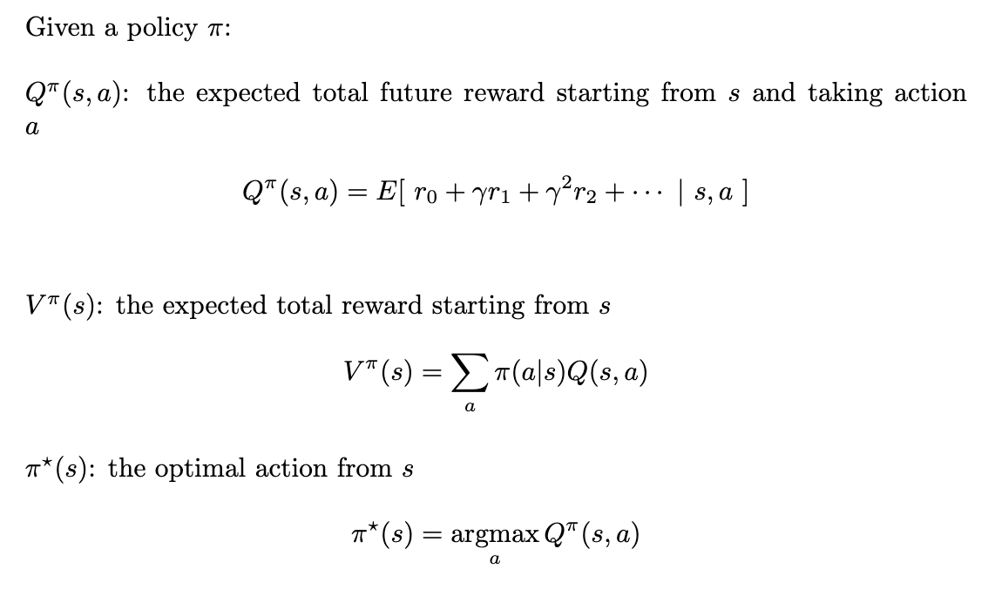
Notes:
The beating heart of RL
Q: ‘state-action-value function’ (it’s an expectation w.r.t. pi)
V: ‘state-value function’

Slide 24
Notes:
The beating heart of RL
Q is the ‘state-action-value function’ (it’s an expectation w.r.t. pi)
V is the ‘state-value function’

Slide 25
Notes:
The beating heart of RL
Q is the ‘state-action-value function’ (it’s an expectation w.r.t. pi)
V is the ‘state-value function’
Pi can be deterministic or stochastic.
Q-learning -> generates deterministic policy. In this paper, pi-star is deterministic.

Slide 26
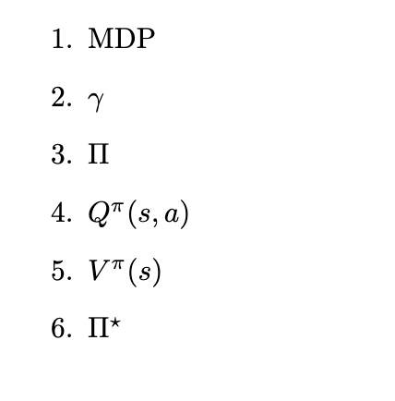
Pop Quiz
Notes:
Covered a lot of ground so far –take a breath and check our understanding
MDP = {S,A, T, R, gamma}
Q and V are defined in terms of a specific policy. Doesn’t make sense otherwise

Slide 27
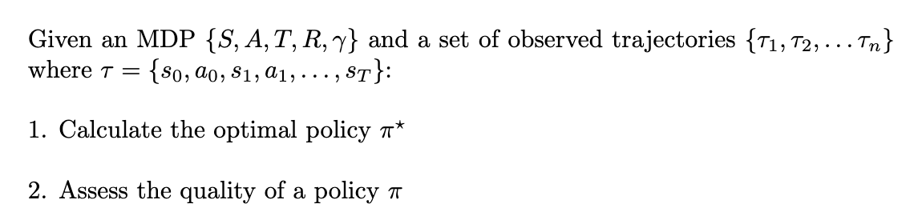
Two key problems in RL
Notes:
Cover 1 now, and 2 later.

Slide 28
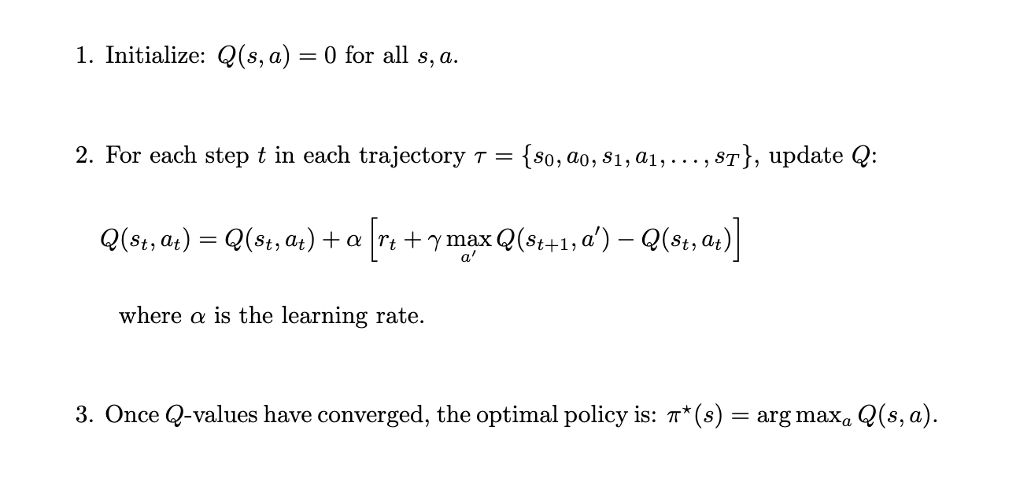
Q-Learning
Notes:
(learning an optimal policy)
They use policy iteration in the paper, which is slightly different, but I find Q-learning easier to explain and understand

Slide 29
Q-Learning
Notes:
Q update - a version of Bellman's equation

Slide 30
Q-Learning
Notes:
When does this work?
need a large enough dataset so all (q,a) pairs are well represented in the data.
typically you want to decay alpha over time - typical ML approach

Slide 31
Halftime

Slide 32
Notes:
Back to the komorowski paper specifically

Slide 33
Outline
Sepsis
RL Refresher
Experimental Setup
Off-Policy Learning
Results
Concerns

Slide 34
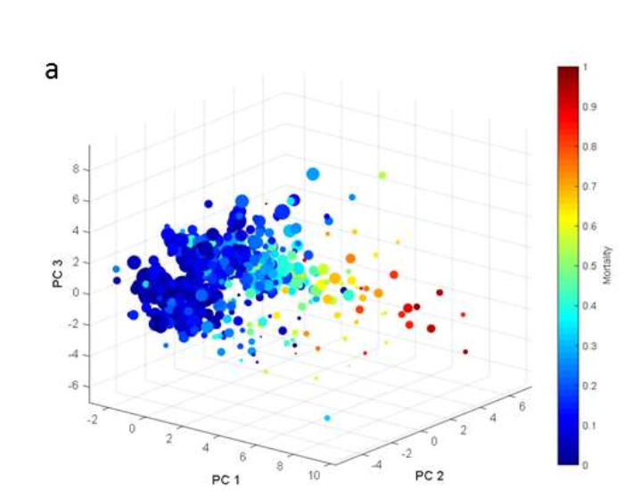
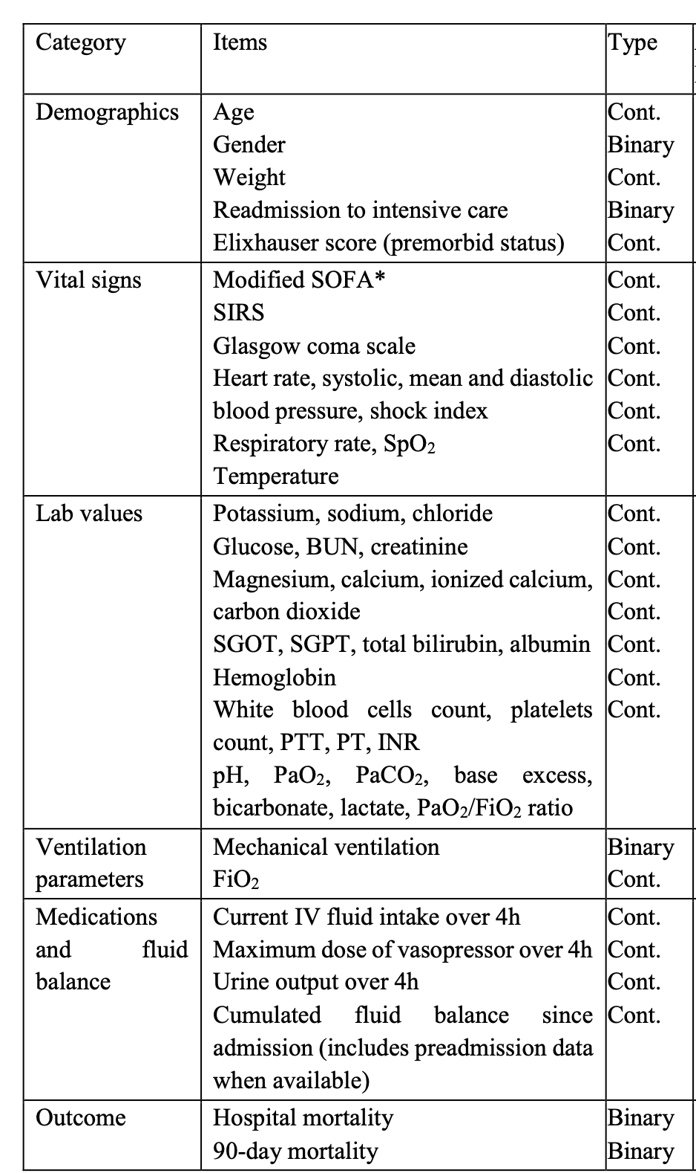
State Space
k-means++ clustering
750 discrete states
(Take state snapshot every 4h)
https://arxiv.org/pdf/1903.02345
Notes:
Note color coding to average mortality in that state. Some states are very dangerous! This suggests the mapping to states is doing something useful/meaningful.
750 discrete states and 25 actions
(kmeans++: version of k-means where you select the initial centroids more intelligently than random – pick 1st centroid randomly, then pick next centroid so that prob of selecting a point is proportional to longest distance to existing centroids)

Slide 35
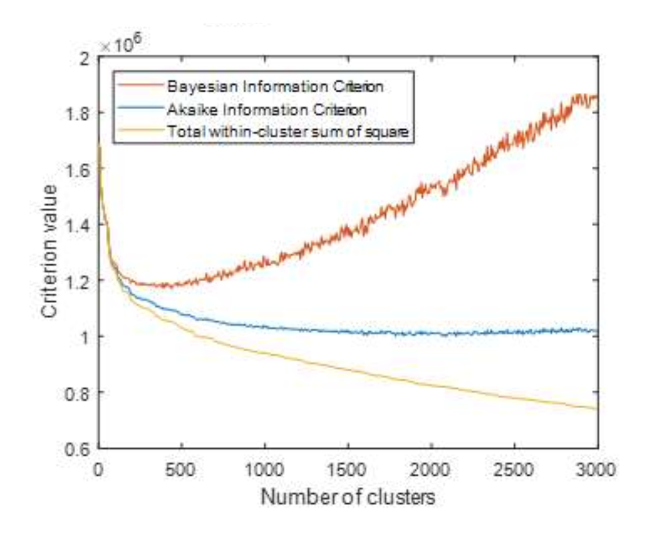

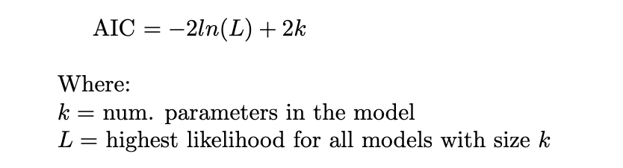
How Many Clusters?
Use Bayesian and Akaike information criteria to determine the optimal number of clusters
Notes:
# clusters k is a hyperparameter
want some principled way of selecting k
Use AIC or Bayesian informatiton criterion

Slide 36
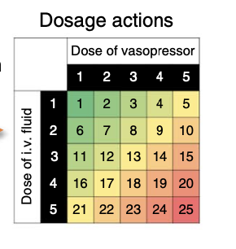
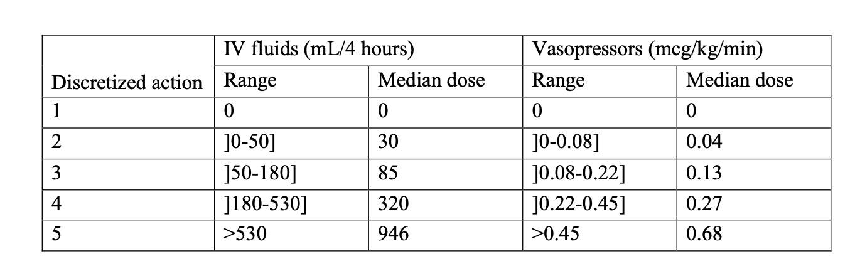
Action Space
Notes:
Ok, so that's how we discretize the state space.
Now let's talk about discretizing the actions.
What do you notice about the table? Ranges for IV fluids - 180-530 in state 4. Not very prescriptive!
Followup papers built model to give a specific number, not a range.

Slide 37
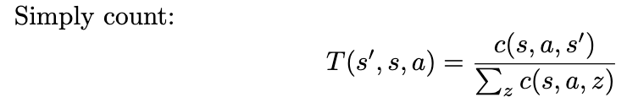
Estimating the MDP Parameters
Notes:
(Remmeber, this is not the policy it’s just the inherent bevaior of the MDP – independent of any policy)

Slide 38
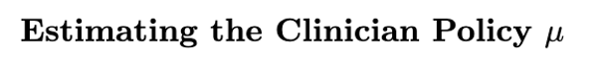
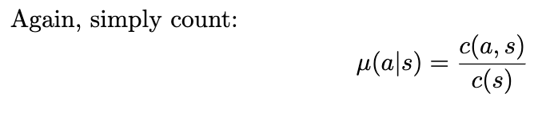
Notes:
Again, we can count up for the clinician policy.
What about the AI policy? Much harder!

Slide 39
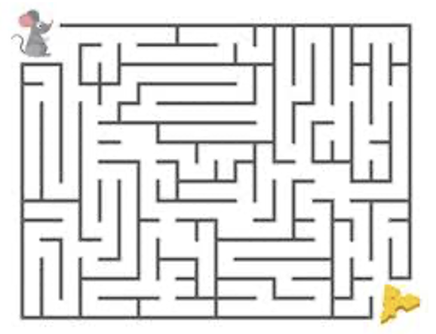
Reward Signal
At 90d, R=100 if patient survived and R=-100 if not
Notes:
And lastly, we need to define the reward signal
This is sparse.
Arguments both ways

Slide 40
Outline
Sepsis
RL Refresher
Experimental Setup
Off-Policy Learning
Results
Concerns
Notes:
Probably the trickiest part
Intentionally deferred talking about this until now.
Typical RL application: agent is actively exploring their environment and learning a policy, combination of exploration and exploitation.
NOT HERE

Slide 41
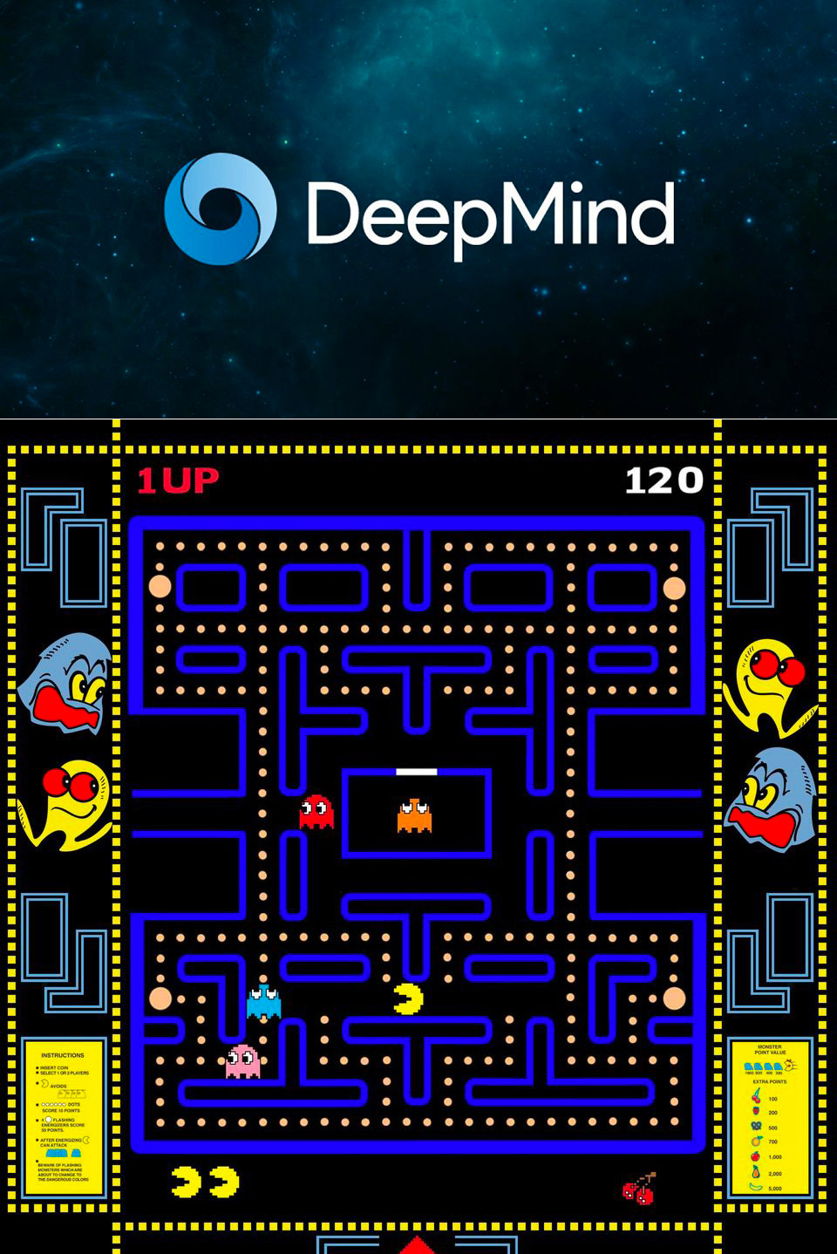
Online vs. Offline RL
Online
Agent learns while doing. Take actions, see reward/state, update model.
Offline
Agent learns policy from a (static) set of previously-collected experiences. Agent does not interact with environment during learning.
a.k.a. “off-policy learning”
Notes:
What’s the problem with each approach?
Online: you could kill someone
Offline: The dataset has a bias (towards the observed policy). You may not have sufficient coverage to even find the optimal policy!

Slide 42
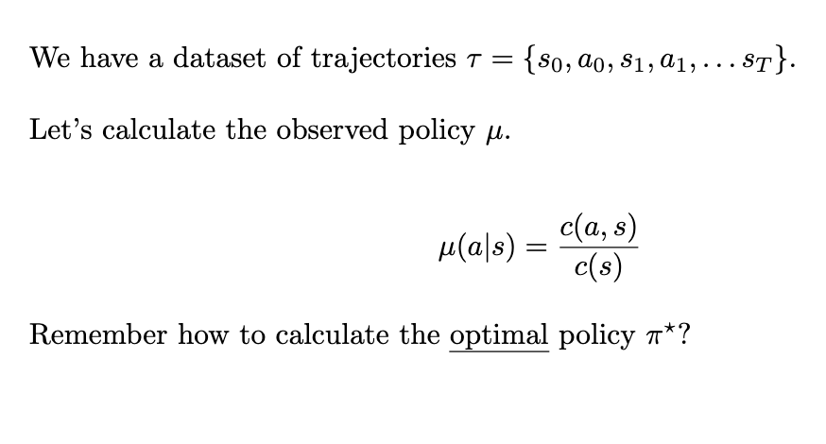
Off-Policy Learning
Notes:
Let's formalize this off-policy learning
This is what Komorowski paper does
Off-policy: learn a policy DIFFERENT from the one that generated the data. Use Q-Learning

Slide 43
Off-Policy Learning
Notes:
Offline, Off-policy – this is what Komorowski paper does
Off-policy: learn a policy DIFFERENT from the one that generated the data.

Slide 44
Q-Learning
Notes:
(showed this before)

Slide 45

Q-Learning on Offline Data
Notes:
This should not work!
Bias in the observed dataset.
Made decisions based on clinician policy.
Analogy1: How am I going to learn how to drive well from watching a toddler drive?
Analogy2: How am I going to learn how to play chess from watching a monkey play chess?

Slide 46

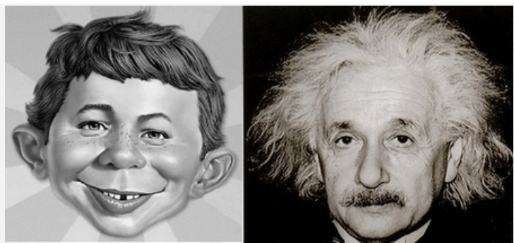
And yet it does. Why?
Q-Learning can “find the smart behaviors” in a dataset full of smart and dumb behaviors
Attributed to Sergey Levine

Slide 47
Off-Policy Evaluation (OPE)
Now let’s evaluate (score) this new policy.
We do that by estimating the total reward (“return”) for this policy on the observed data.
Notes:
Ok, we’ve learned the optimal policy.
Can we measure what is the expected gain/reward for pi star?

Slide 48
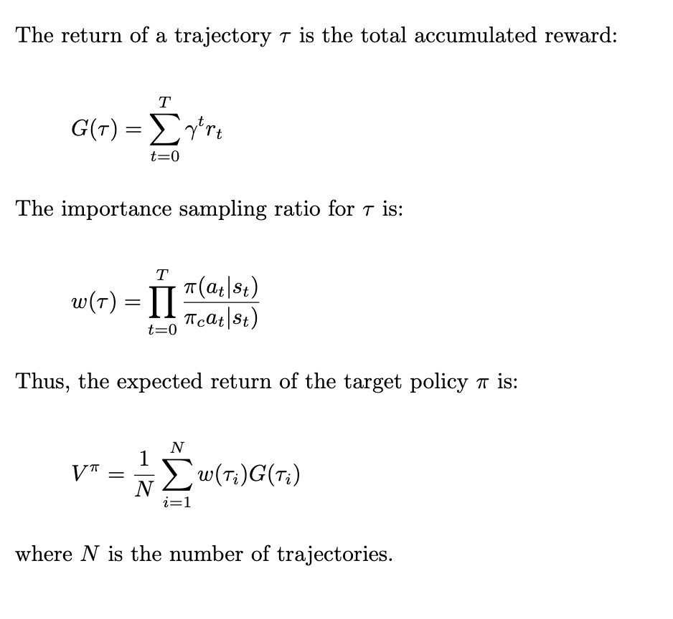
Off-Policy Evaluation (OPE)
Notes:
Let’s step through it
(return a.k.a. Gain)

Slide 49
Off-Policy Evaluation (OPE)
“importance sampling”
Notes:
WIS = give more weight to trajectories that are more likely to have been generated by the policy you're learning
Analogy: Give more weight to a chess game where the player played smart vs dumb.

Slide 50
Off-Policy Evaluation (OPE)
Notes:
Total expected return for a candidate policy on the given trajectories is the weighted average of the gain on those trajectories
DOES ANYONE SEE A PROBLEM HERE?
hint: look at the ratio here. pi is the new policy, pi_c is clinician.
(technical detail – paper uses *weighted* importance sampling, which normalizes the W(T) values)

Slide 51
Off-Policy Evaluation (OPE)
Uh oh! This will be zero for lots of trajectories!
Solution: add 1% stochasticity to policy!
Notes:
there's a point in the paper where they talk about how the zero-drug policy actually does surprisingly well.
reason for this is subtle
for zero drug policy, p(drug|s) = 0. So it discounts all trajectories to zero where the clinician adminstered drugs. Leaving only the healthy patients.

Slide 52
Outline
Sepsis
RL Refresher
Experimental Setup
Off-Policy Learning
Results
Concerns

Slide 53
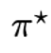
Experimental Setup
Do 500 times:
Select a random 80% of MIMIC training set
Build a model from this set
Evaluate it on the heldout 20%
Also evaluate observed, random, and “zero-drug” policy on same 20%
Select best-performing model . Evaluate it on the separate (eRI) dataset.
Notes:
Bootstrapping approach
“Best-performing” – eval each model on 100 (say) different cuts of the heldout data, what’s the 95% LB?

Slide 54
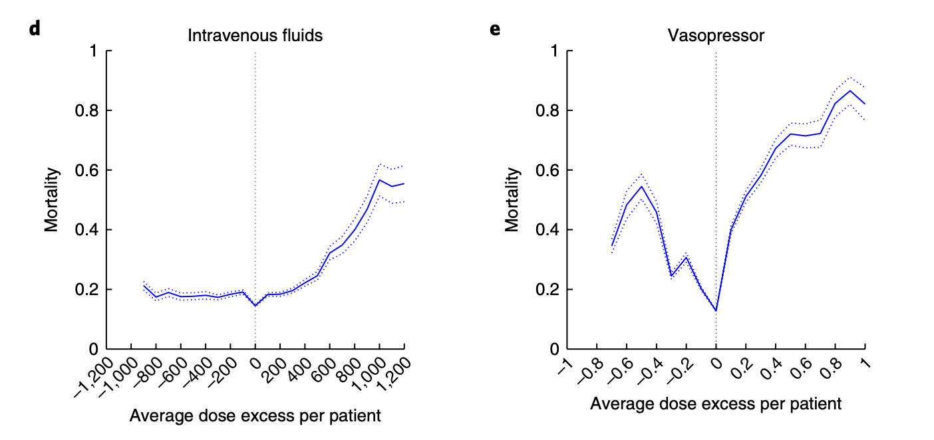
Notes:
The more the clinician and AI policy diverge, the worse the outcome
Dotted line – confidence interval

Slide 55
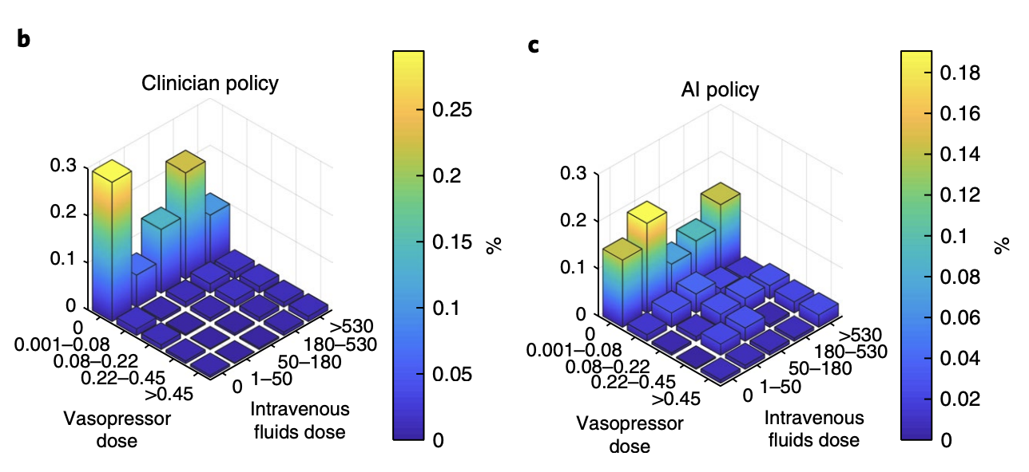
Notes:
Clinicians administered moreo IV fluids than the AI clinician
Clinicians administered less vasopressors than AI clinician
(height: how much relative mass is on each cell)
“The proportion of time the eRI patients received vasopressors was only 17%, but this would have been 30% if the AI Clinician’s recommendation was followed”

Slide 56
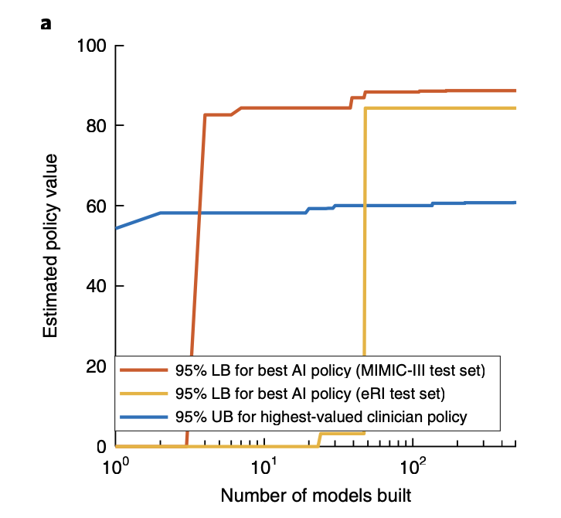
Notes:
just look at the slice at 10^2

Slide 57
Outline
Sepsis
RL Refresher
Experimental Setup
Off-Policy Learning
Results
Concerns

Slide 58

Concerns

Slide 59
Concerns
Off-policy evaluation is hacky
5x5 action space
4h time resolution
Sparse and binary reward
Markov assumption
Iatrogenic risk
Notes:
More concerns – see the optional papers
What does iatrogenic mean?

Slide 60
<EOL>

